Slide 1
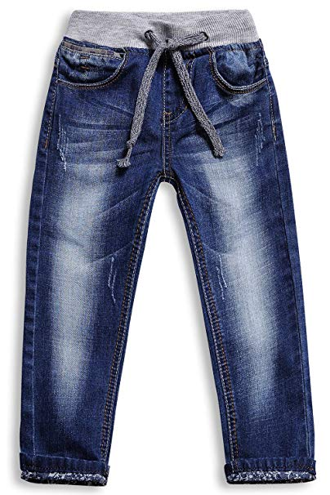
Apparel Design BD
Style : ADBD-1
Description : Boys Denim pant
Fabrics : 97% Cotton,3 % spandex, 10 OZ

Slide 2
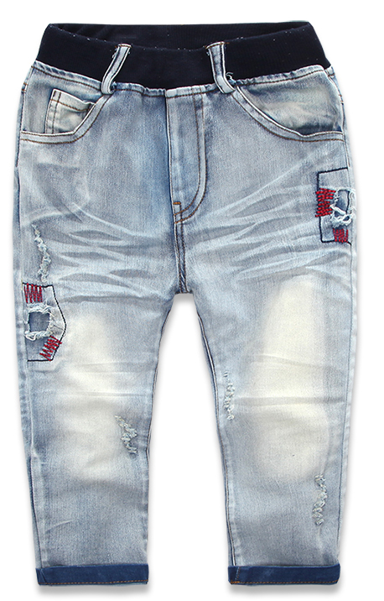
Apparel Design BD
Style : ADBD-2
Description : Kids Denim Pant
Fabric : 97% Cotton,3 % Spandex, Knit Denim

Slide 3
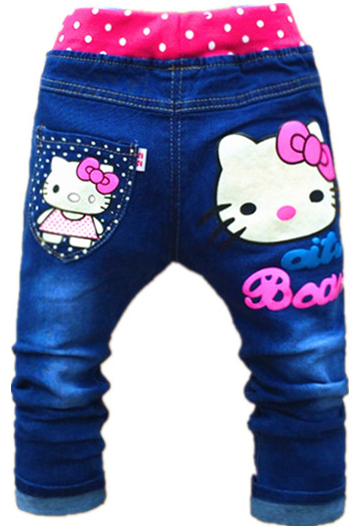
Apparel Design BD
Style : ADBD-3
Description : Kids Denim Pant
Fabric : 97% Cotton,3 % Spandex, Knit Denim

Slide 4
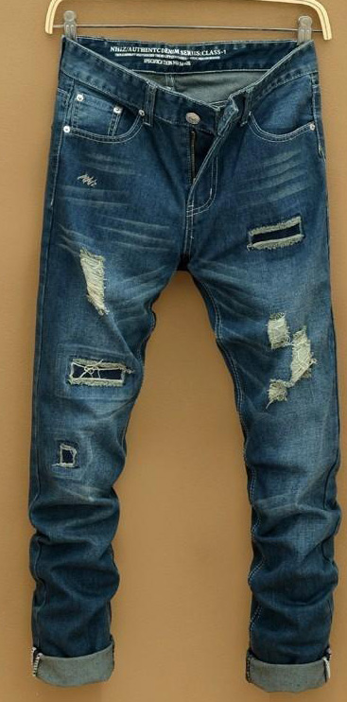
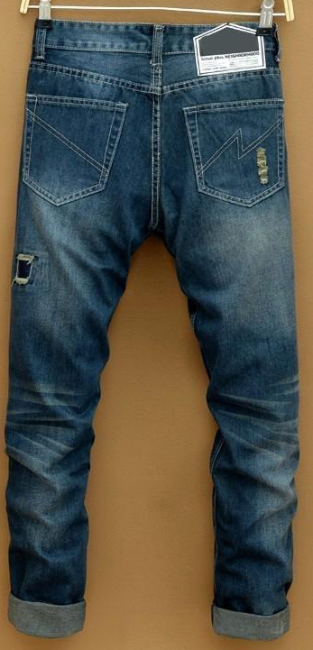
Apparel Design BD
Style : ADBD-4
Description : Boys Denim Pant
Fabric : 95% Cotton,5 % Spandex, 10 OZ

Slide 5
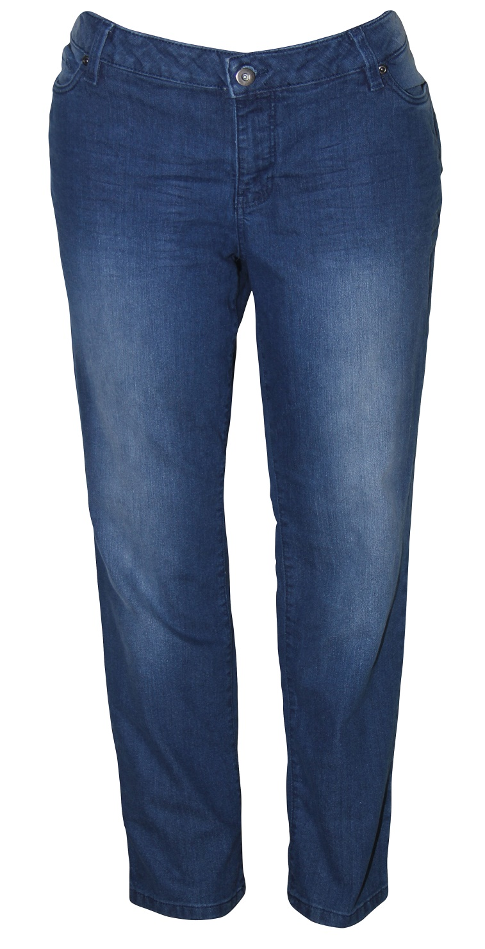
Apparel Design BD
Style : ADBD-5
Description : Ladies Denim Pant
Fabric : 97% Cotton,3 % Spandex, 10 OZ

Slide 6
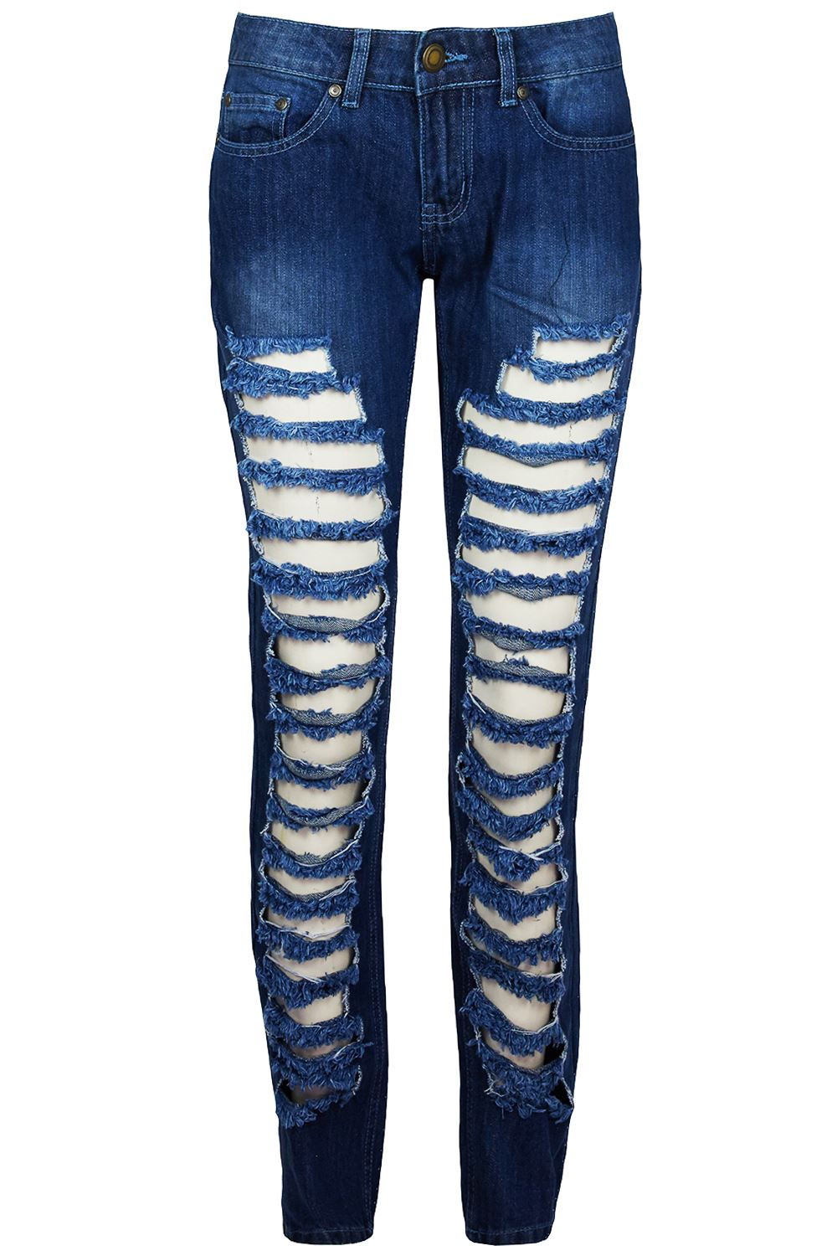
Apparel Design BD
Style : ADBD-6
Description : Ladies Denim Pant
Fabric : 95% Cotton,5 % spandex, 8 OZ

Slide 7
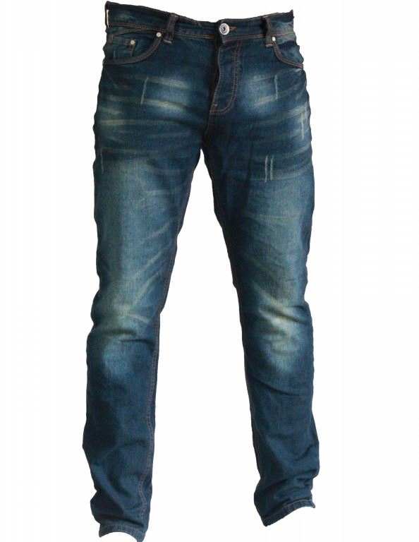
Apparel Design BD
Style : ADBD-7
Description : Men's Denim pant
Fabric : 95% Cotton,5 % spandex, 11.5 OZ

Slide 8
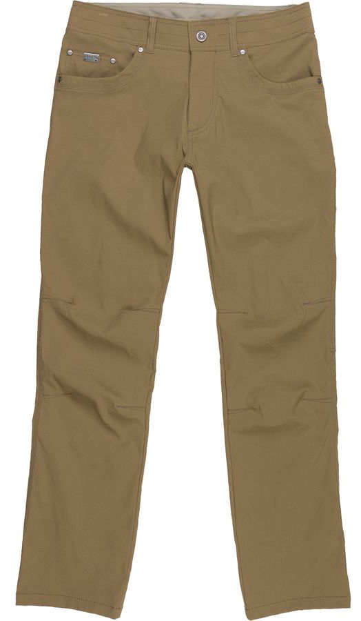
Apparel Design BD
Style : ADBD-8
Description : Men's Twill Pant
Fabric : 97% Cotton,3 % spandex, Twill 11 OZ

Slide 9
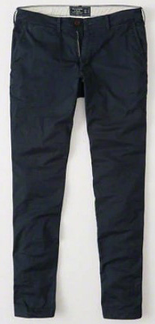
Apparel Design BD
Style : ADBD-9
Description : Men's Twill Pant
Fabric : 97% Cotton,3 % Spandex, 10 OZ

Slide 10
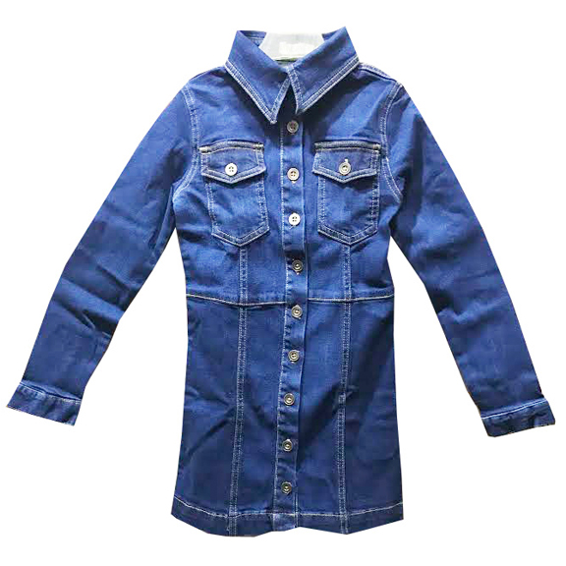
Apparel Design BD
Style : ADBD-10
Description : Denim Shirt
Fabric : 97% Cotton,3 % Spandex, 8OZ

Slide 11
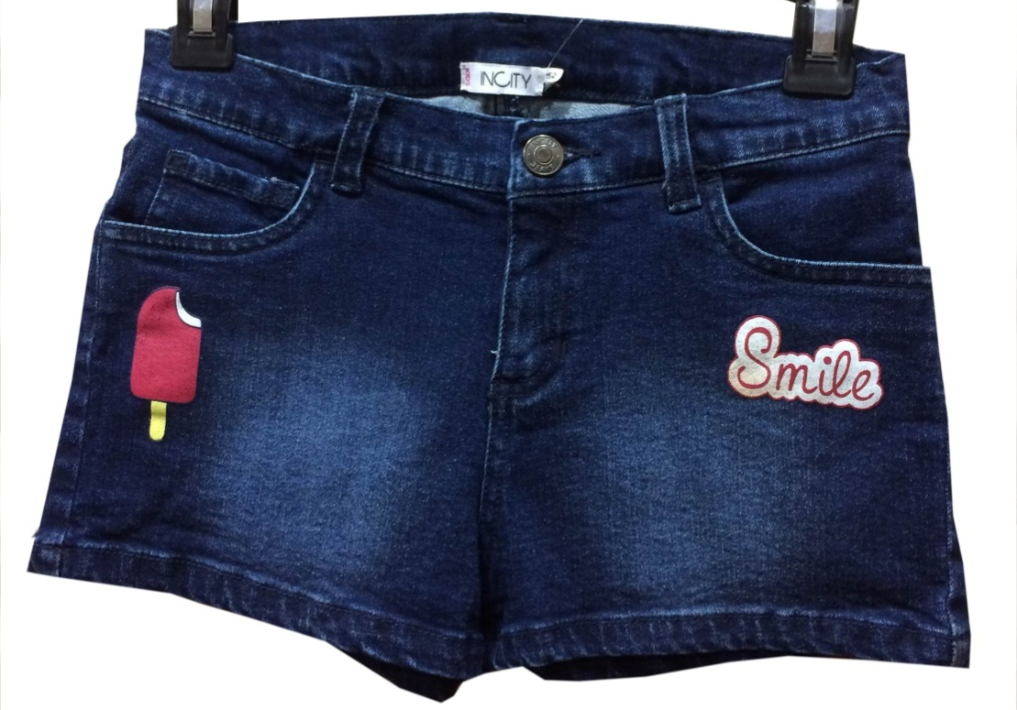
Apparel Design BD
Style : ADBD-11
Description : Kids Denim Shorts Pant
Fabric : 97% Cotton,3 % Spandex, 8OZ

